Slide 1

House Price Prediction: A Data-Driven Approach
Leveraging Machine Learning to Uncover Property Value Trends
Team members:
Aravind
Akshara
Sravani
Prudhvi
Adithya
Raj Kumar

Slide 2
Introduction
Real estate valuation is crucial but challenging due to dynamic market conditions and varied property characteristics.
House price prediction impacts buyers, sellers, and investors, ensuring fair valuations and informed decisions.
Machine learning provides a data-driven approach, moving beyond traditional methods.

Slide 3
Problem Statement
Real estate valuation remains a challenge due to the complex interplay of factors influencing house prices.
Accurate house price prediction is critical for buyers, sellers, and investors.
Machine learning provides an opportunity to address these challenges using data-driven insights.

Slide 4
Suggested Solution
Development of a predictive model using machine learning.
Integration of algorithms like linear regression, Ridge regression, Decision Tree, and gradient boosting to account for both linear and non-linear data relationships.
Tailored preprocessing to ensure data quality.

Slide 5
Methodology Overview
PROBLEM UNDERSTANDING
DATASET ACQUISITION
DATASET UNDERSTANDING
DATA CLEANING
MODEL EVALUATION
MODEL DEVELOPMENT
FEATURE ENGINEERING
DATA ANALYSIS
PREDICTION
INSIGHTS AND DEPLOYMENT

Slide 6
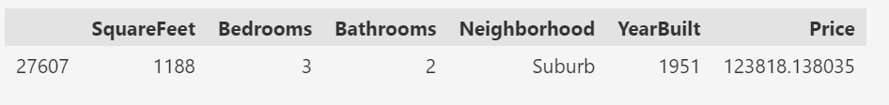
Dataset Overview
Dataset: Housing Dataset, comprising 6 features across over 50,000 entries.
Key features : SquareFeet, Bathrooms, Bedrooms, YearBuilt, Neighbourhood.
Target variable: Price.
Dataset Instance

Slide 7
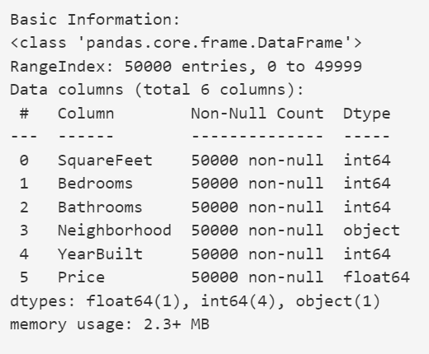
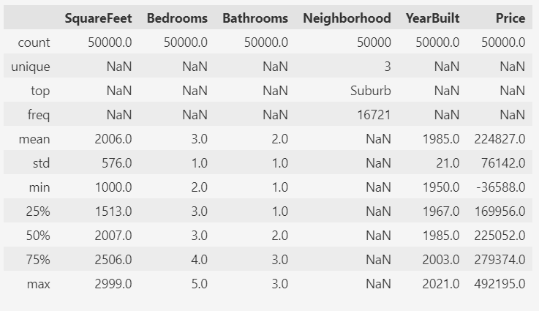
Dataset Overview
Basic Information:
Statistics:

Slide 8
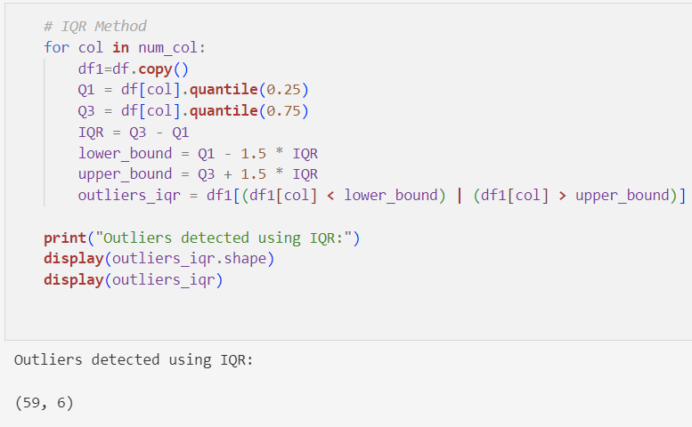
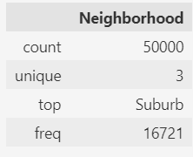
Challenges Faced
Data Quality
Data Quality Issues
Feature Encoding
Feature Scaling
Categorical feature

Slide 9
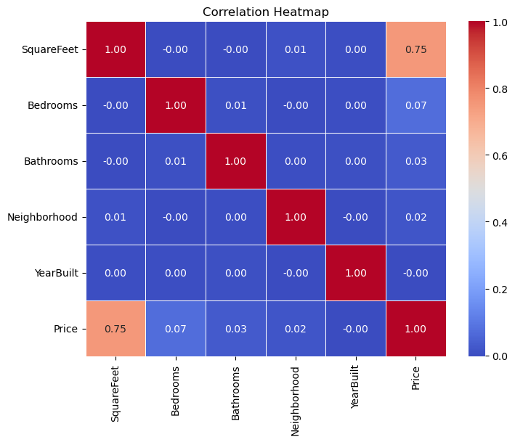
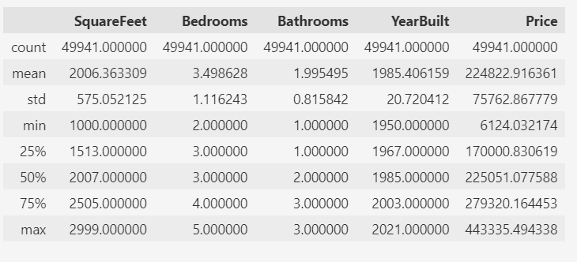
Data Analysis
Correlation analysis revealed strong relationships.
Distribution of Features.
Descriptive Statistics

Slide 10
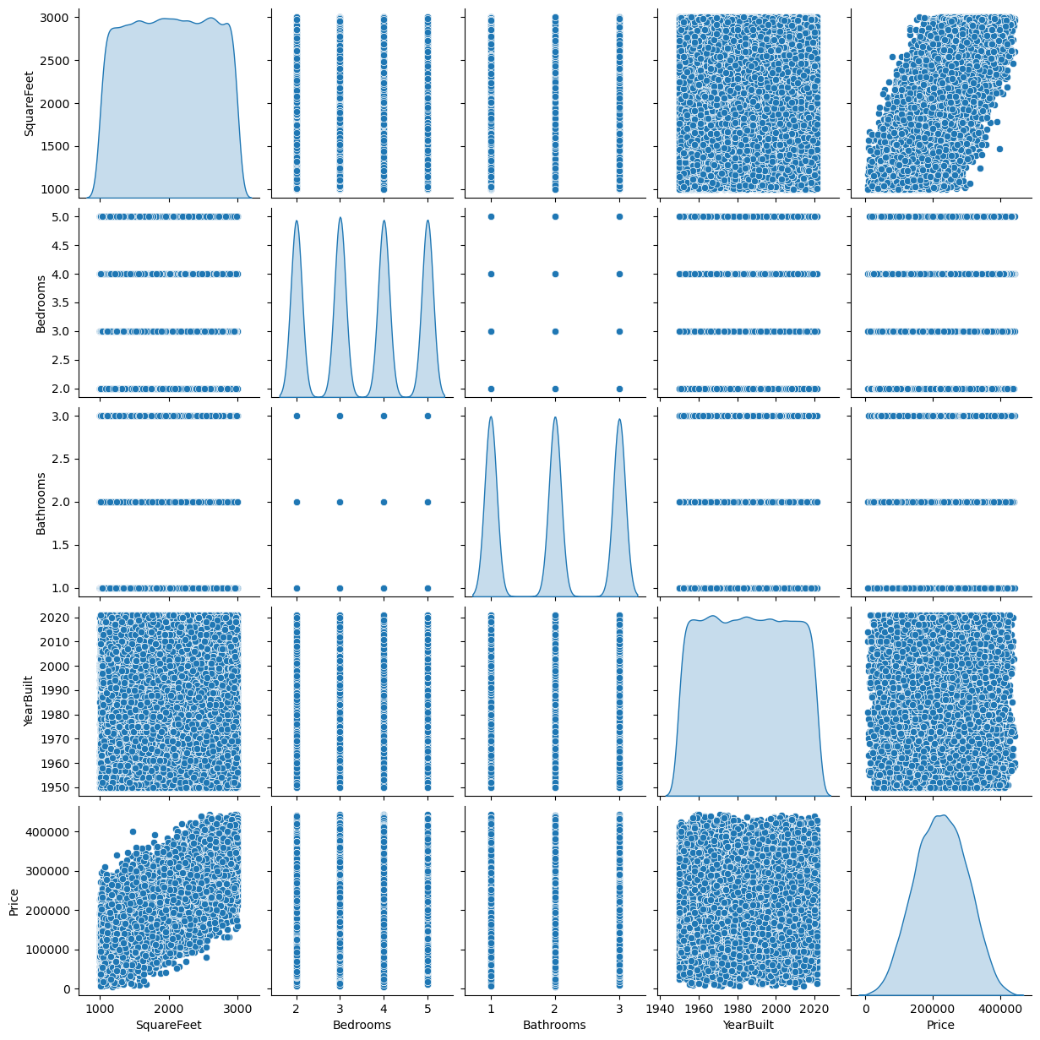

Slide 11
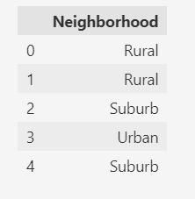
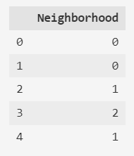
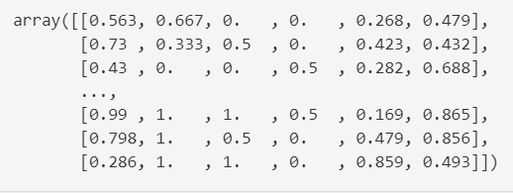
Feature Engineering
Categorical Encoding
Feature Scaling
Feature Selection
Encoding
Normalization

Slide 12
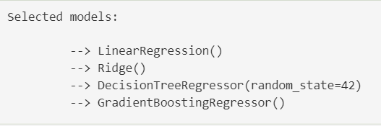
Algorithms Considered
Linear Regression
Ridge Regression
Decision Tree
Gradient Boosting
Machine Learning Models

Slide 13
Model Development
Train-Test Split: Dataset divided into 80% training and 10% testing and 10% validating sets.
Ensures the model is trained using the training dataset (80%).
Models were tested on the remaining 10% of the data.
To evaluate and 10% validation of the data to their generalization performance.
Scikit-Learn libraries: fit() for training, predict() for testing.

Slide 14
Model Evaluation
Mean Absolute Error (MAE): Measures the average magnitude of errors in the predictions (lower is better).
Mean Squared Error (MSE): Measures the average squared difference between predicted and actual values (lower is better).
R² Score: Measures the proportion of variance in the target variable explained by the model (higher is better)

Slide 15
Model Comparison
 | Training |  |  | Validation |  |  | Testing
Model | MSE | MAE | R^2 | MSE | MAE | R^2 | MSE | MAE | R^2
Linear Regression | 2470163629.81 | 39756.1 | 0.57 | 2493067371.94 | 39919.3 | 0.563 | 2443366382.00 | 39813.2 | 0.57
Ridge Regression | 2470163629.84 | 39756.1 | 0.57 | 2493067079.14 | 39919.3 | 0.563 | 2443366090.34 | 39813.2 | 0.57
Decision Tree Regression | 7650423.116 | 184.5 | 0.999 | 5184065558.56 | 58047.3 | 0.092 | 5112811302.140 | 57296.8 | 0.101
Gradient Boosting | 2444352292.13 | 39552.2 | 0.575 | 2496180177.95 | 39911.2 | 0.563 | 2451703814.820 | 39870.3 | 0.57

Slide 16
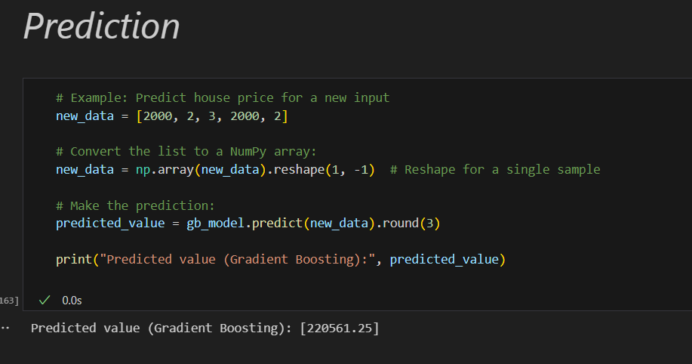
Results

Slide 17
Future Work
Incorporating additional features & the impact of factors like property taxes, school district quality, and proximity to amenities.
Enhancing model accuracy with advanced algorithms like XGBoost & Hyperparameter.
Real-time updates: Implementing a system to continuously update the model with new data to ensure accurate predictions.

Slide 18
Conclusion
Successfully built a predictive model for house prices with high accuracy.
Completed end-to-end pipeline: data cleaning, feature engineering, modeling, evaluation, and validation.
The Gradient boosting model performed the best in predicting house prices.
This model can be used in real estate to predict house prices based on various factors, assisting buyers and sellers in making informed decisions.

Slide 19
References
Dataset Source
Mention where the dataset was obtained (e.g., Kaggle, UCI Machine Learning Repository).
Example: "Dataset Source: Kaggle - House Price Prediction Dataset".
Tools and Libraries
Python Libraries:
Scikit-Learn (for model building and evaluation)
Pandas and NumPy (for data manipulation)
Matplotlib and Seaborn (for data visualization)

Slide 20
Question & Answer session

Slide 21
Thank You
Presented by
Aravind
Akshara
Sravani
Prudhvi
Adithya
Raj Kumar

